Slide 1
Reviews Rating Prediction

Slide 2
Problem Statement And Understanding
A client who has a website where people write different reviews for technical products is introducing the ‘add star’ feature to their website.
The company wants to use data science and Machine Learning techniques to predict the ratings for the review which were written in the past that does not have a rating.
The goal is to build an application which can predict the rating by seeing the review.

Slide 3
Data Collection and Ingestion.
Scraping data: data_collection.ipynb
Selenium webdriver was used to scrape data from websites.
Data was scraped from Amazon, Flipkart and Snapdeal websites. There are some outliers in the dataset.
Data Ingestion: data_ingestion
The scraped data from different sites are combined and stored together in a single file.

Slide 4
Exploratory Data Analysis
This is a Multi-class classification problem. The target variable contains numeric integers 1, 2, 3, 4 and 5. 1 being poor and 5 being excellent.
Variable Data-types:
The dataset contains Reviews and Ratings fields which are scraped from Amazon, Flipkart and Snapdeal sites for different products.
Null Values: There are NO Null values in the dataset.
Shape: There are 280332 records and 1 feature + 1 target variable in the whole data.
The dataset has text features.

Slide 5
Exploratory Data Analysis cont..
The original data is imbalanced with the classes:
class 5 has 129705 samples
class 4 has 61298 samples
class 1 has 49773 samples
class 3 has 24843 samples
class 2 has 14713 samples
The Duplicates are droped from the original dataset. After dropping duplicates, there are 190067 records.
Sampling:
Sampling technique was used to balance the dataset.
Upsampling gave better model performance than downsampling.
Google Translator was used for upsampling the data.
The up-sampled data is balanced with 83244 samples for each class.
Shape: There are 416220 records and 1 feature + 1 target variable in the up-sampled data.
The dataset has text feature and numeric target fields

Slide 6
Data Cleaning
Data Cleaning Approach:
Email addresses are converted to the text ‘emailaddress’.
Web site links are converted to the text ‘webaddress’
Phone numbers are converted to the text ‘phonenumber’
Currencies are converted to the text ‘currencyamount’
Numbers are converted to the text ‘numbr’.
The non-alphabetic characters are removed from the review texts.
Extra white spaces are removed.
Stop words are removed.

Slide 7
Text data Encoding
TFIDF was used to encode the text data ‘reviews’:
Monograms, bigrams and trigrams are used.
10,000 is used as the max_feature value to avoid memory error and slowness.
Adding more than 10000 features did not show significant increase in the model performance till max_features = 25000.
Using max_features > 25000 takes too long to execute.

Slide 8
Visualizations

Slide 9
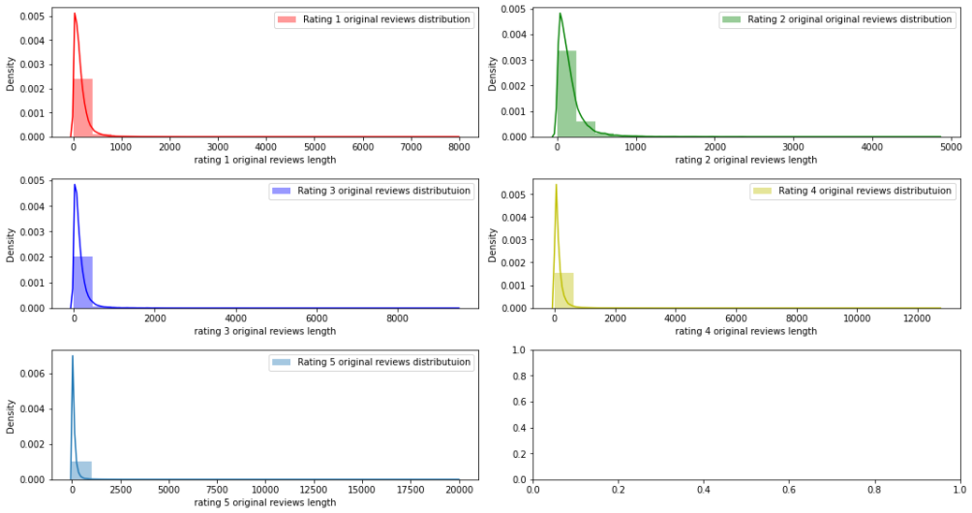
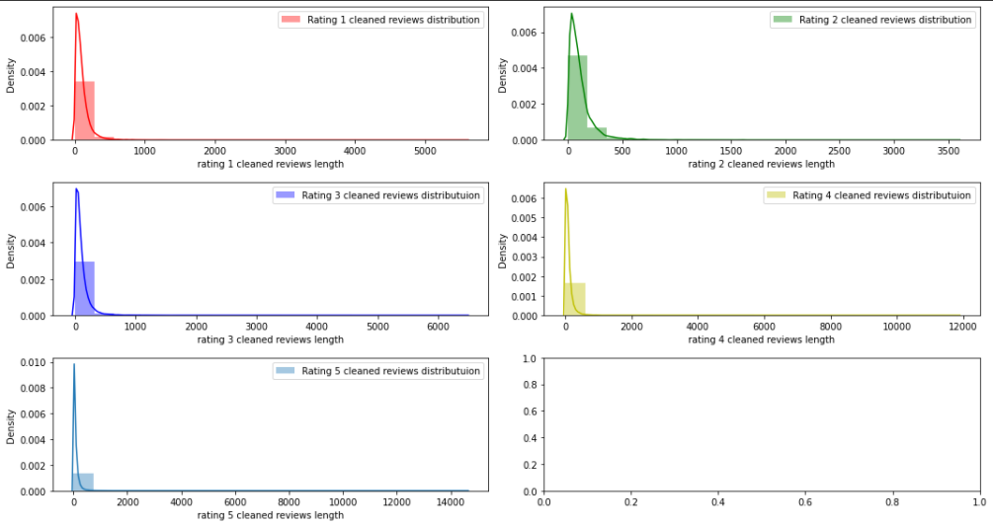
Distribution of the original review lengths(left) and cleaned review lengths(right)

Slide 10
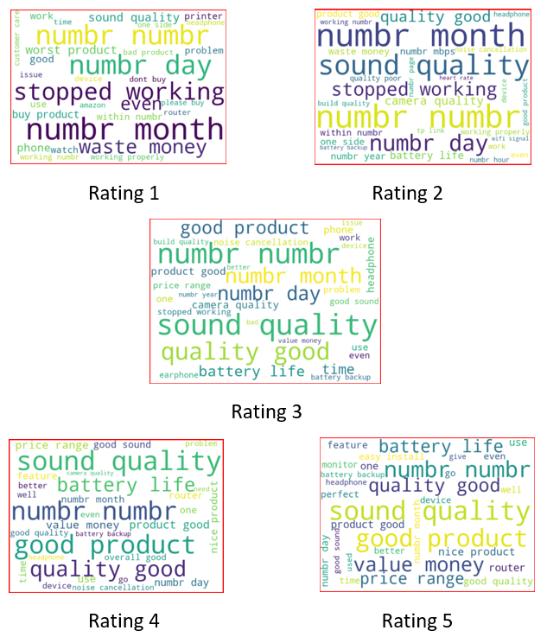
Ratings Word Clouds
We can see that there is a clear distinction between the words used in the reviews of Rating 1 and Rating 5.
The Rating 1 reviews have many negative words for eg: 'Stopped working', 'waste money', 'bad product', etc,.
The Rating 5 reviews have many positive words for eg: 'value money', 'nice product', 'better', 'good quality'.
Some of these positive words in Rating 5 reviews are also available in Ratings 3 and 4. Also, there are some other words in the word cloud that are unique to Ratings 3, 4 and 5 respectively.
Hence monogram, bigram and trigram are used in TFIDF.

Slide 11
Steps taken to complete the Project
Performed data cleaning based on NLP approaches.
Trained and validated different Machine Learning classification models(base and ensemble models) to select a suitable model.
Chose the final model based on Accuracy and Classification Report.

Slide 12
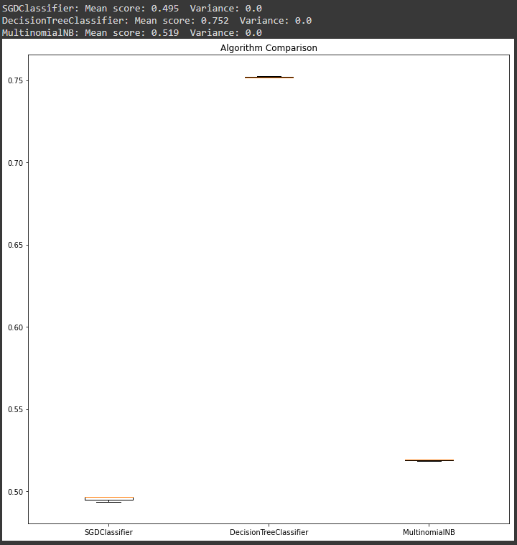
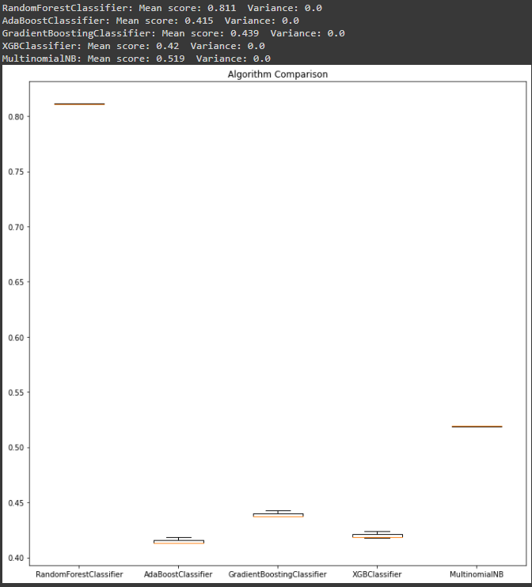
Model score comparison
Simple Models(left) and Ensemble models(right)

Slide 13
Finalized Model
The final model used is RandomForestClassifier
The tuned hyper parameters used are:
n_estimators = 233,
min_samples_split = 2,
min_samples_leaf = 1,
max_features = 'auto',
max_depth = 100

Slide 14
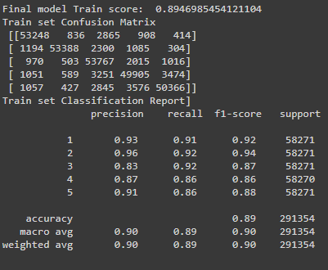
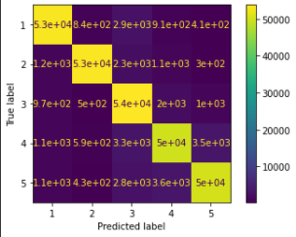
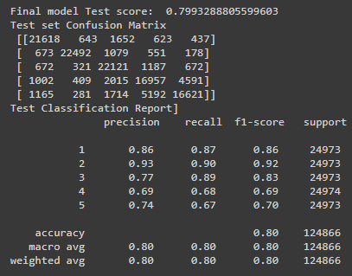
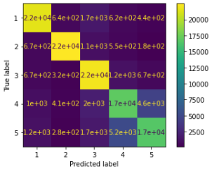
Finalized Model
Scores with train and test data:

Slide 15
Conclusion
The RandomForestClassifier is giving a better result than the other algorithms.
The performance shows low bias and low variance.

